Slide 1
Lucky Kávéző
Presentation
By Balint Pach

Slide 2
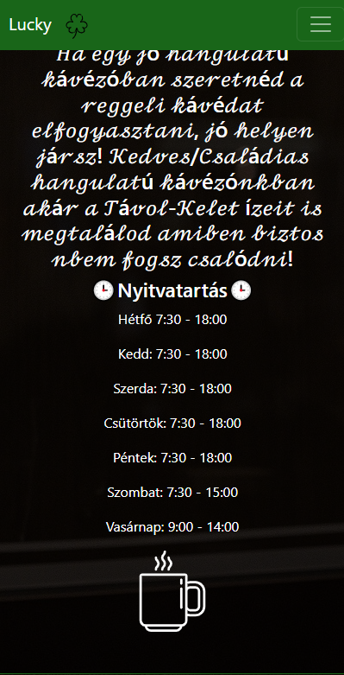
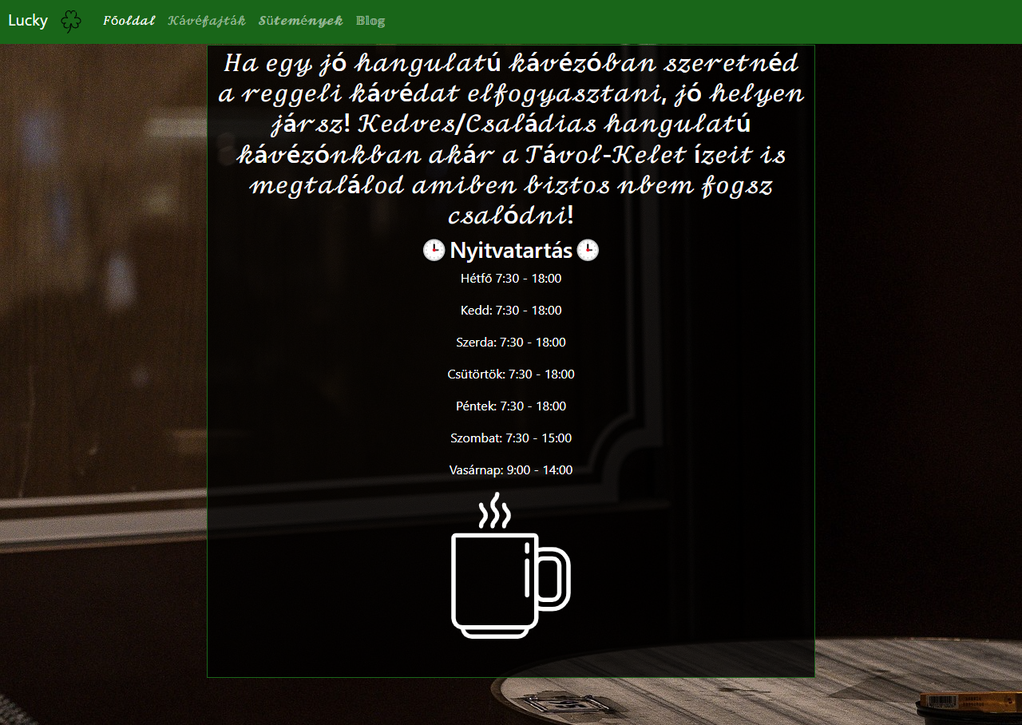
Customer’s expectation
It needs to be responsive, to work properly on every platform, to satisfy every customer.
Mobile view: PC view:

Slide 3

For start
It should be modern and contemporary
It needs to be open source
Be responsive
2 pages minimum
Needs to include HTML5, CSS3
Navigation: The webpage should be easy to
Navigate, with clear structure and intuitive links
Between pages.

Slide 4
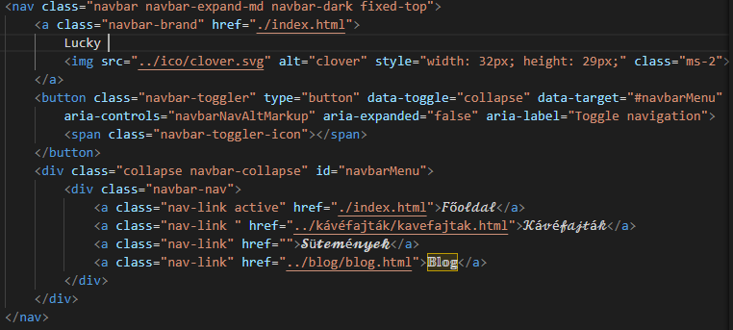
Implementation
It’s responsive thanks to bootstrap’s grid system:
It features NAVbar for ease of navigation on the page:
The page has been optimazed, and it’s loading fast.

Slide 5
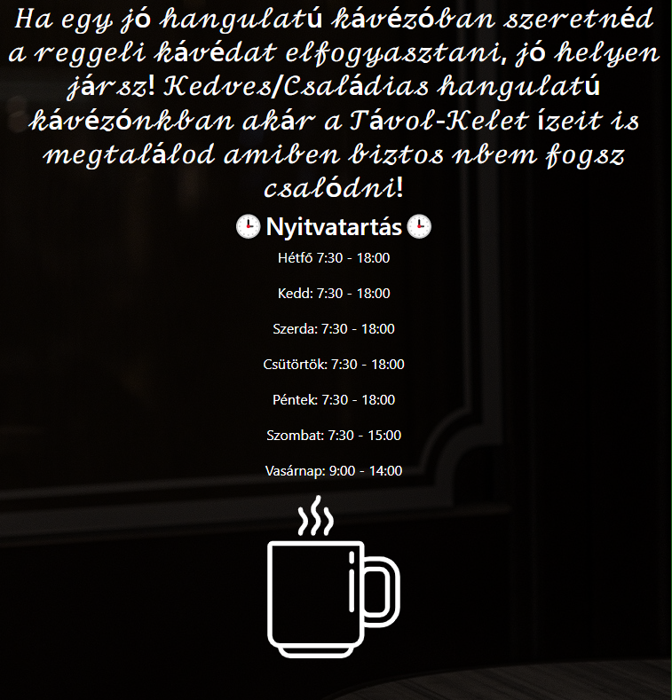
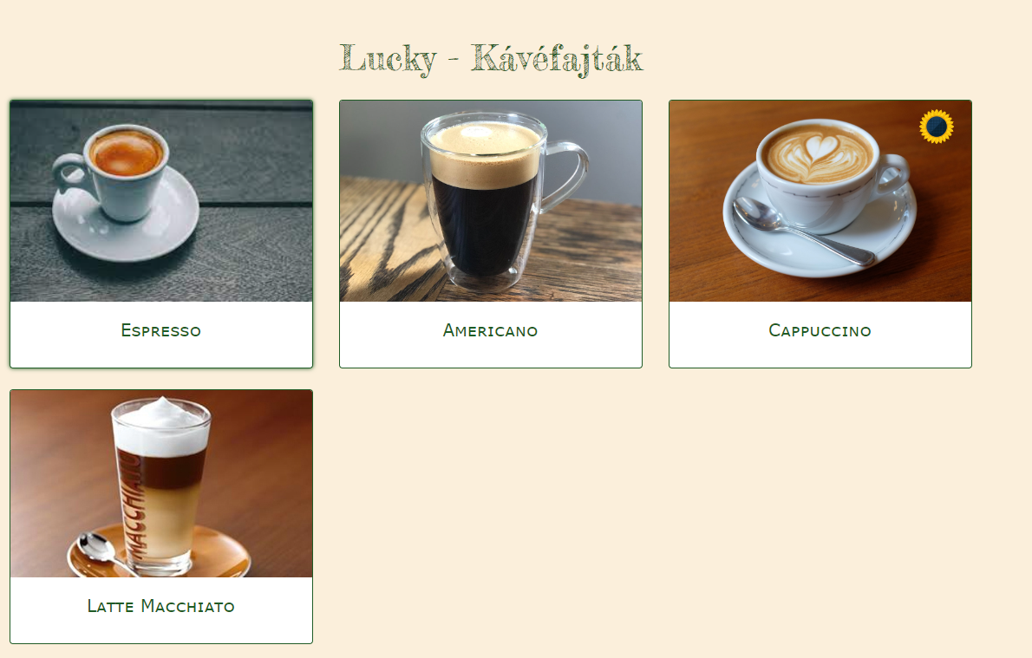
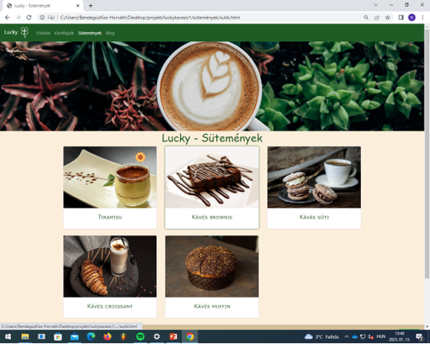
Design
Home page: Coffee types: Cookies:

Slide 6
The WebPage created by:
Boldis Áron
Pach Bálint
Kiss-Horváth Bendegúz

